Slide 1

Continuous Delivery For Modules to the PowerShell Gallery
Rob Sewell @sqldbawithbeard https://sqldbawithAbeard.com

Slide 2



Thank You To Our Sponsors

Slide 3
speaker questionnaire
Name : Rob
Occupation : DBA, Automator, Do-er, Trainer, DevOpser!
Available for hire ☺ - RobSewell.info
Interests : PowerShell, Automation And SQL (PaaS geddit?)
Interesting Fact : Beard. (Still) Plays Cricket, Flies Drone
Speaker : PsConfEU, PsConfAsia, PSSaturdays, PSMondays, User Groups PowerShell and SQL
Community : PowerShell VG, PowerShell Conference EU Organiser, PSDayUK Organiser, SQL South West , SQL Sat Exeter , dbareports, dbatools, SQLDiagAPI, MVP
Crashes

Slide 4
TODAY’s TO DO LIST
GET UP
Drink Appropriate Liquid
Learn Loads at PSDayUK
Create Continuous Delivery Process for Delivering Modules to the PowerShell Gallery

Slide 5
What do we need?
Plaster – Install-Module Plaster
Pester – Install-Module Pester -Force (even though it is installed by default)
GitHub Account
VSTS account
We won‘t have time for much detail!!

Slide 6
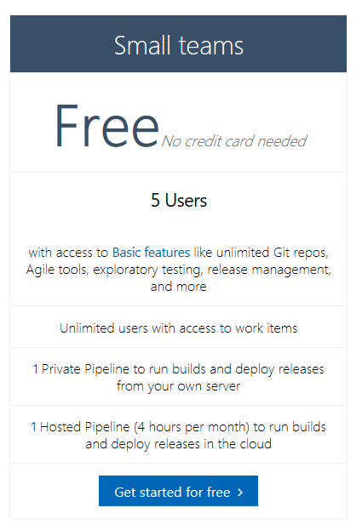
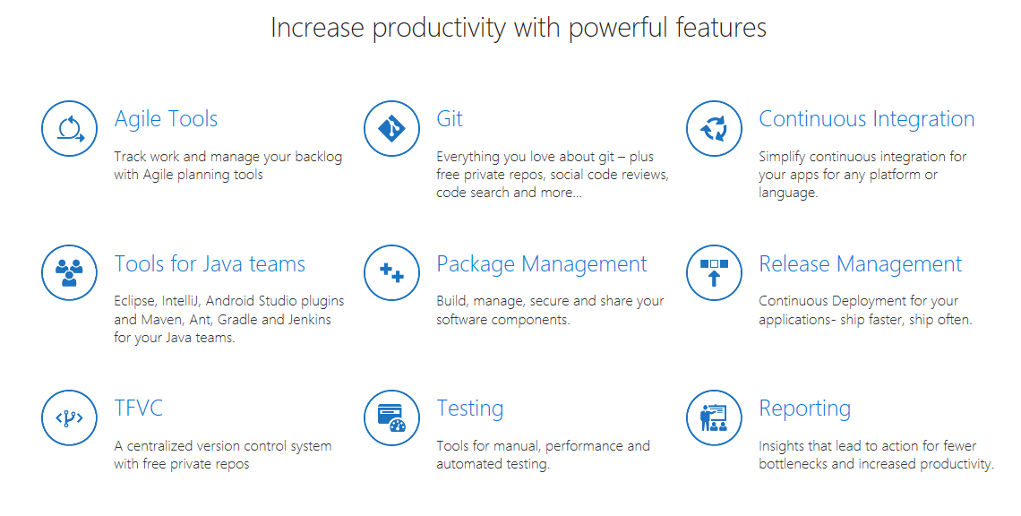
Visual Studio Team Services
https://visualstudio.com/team-service

Slide 7
Why Module?
Ps1 scripts EVERYWHERE!!
Use them in other scripts
Share them
Modularity
Only export functions user needs

Slide 8
Why PowerShell Gallery?
Public or Private Nuget Repository
Share your Modules
Centralise deployment of Modules
PowerShell Gallery is safe and secure
Only export functions user needs

Slide 9
Why Plaster?
Reusability
Parametrisation
Organisational requirements
If you are doing it more than once automate it ☺

Slide 10
Why Pester?
Verify the code is working correctly
Provide design guidance - Support Refactoring
Document the code’s behaviour
Test ScriptAnalyser and Help
If you are doing it more than once automate it ☺
Notes:
Good tests can…
Verify the code is working correctly
Prevent future regressions
Document the code’s behaviour
Provide design guidance
Support refactoring
https://www.devmynd.com/blog/five-factor-testing/

Slide 11

Hey Beardy – Enough Talk!
Time For A DEMO

Slide 12
Summary
Continuous Delivery of PowerShell Module to the Gallery is easy Plaster can template your module framework
Pester is a Unit Testing Framework for PowerShell
VSTS is free
Have Fun – Create some modules today
Rob Sewell @sqldbawithbeard https://sqldbawithAbeard.com

Slide 13
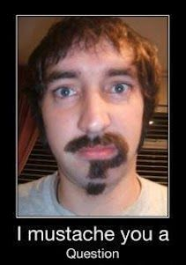
Questions?
?
?
?
?
?
?
?
?
?
?
?
?
?
?
?
?
Rob Sewell @sqldbawithbeard https://sqldbawithAbeard.com

